Slide 1

RADaR Revision
Replace, Add, Delete, and Reorder

Slide 2
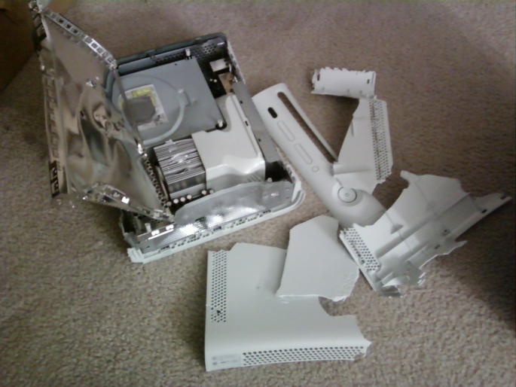
Replace…
words that are not specific
words that are overused
sentences that are unclear

Slide 3
Replace
Before
  As I ran to the finish line, my heart was beating.
  After
  As I sprinted to the tape, my heart was pounding like a bass drum in my chest.

Slide 4
Add…
new information
descriptive adjectives and adverbs
figurative language ie: simile, metaphor, personification, alliteration, onomatopoeia, hyperbole (rhetorical or literary devices)

Slide 5
Add
Before
  Shadows made the night seem scary.
  After
  Ominous shadows made the dark night seem even more frightening.

Slide 6
Delete…
unrelated ideas
sentences that sound good but create (unity) organization problems
unwanted repetition (using the same word over and over, using the same beginning to the sentences, using the same transition words)
unnecessary details

Slide 7
Delete
Before
The candidates talked about the issue, and many of the issues were issues that had been on the voters’ mind
After
The candidates talked about the issues, many of which had been on the voters’ minds.

Slide 8


Reorder…
to make better sense or to flow better
so details support main ideas
Main Idea
Supporting
details

Slide 9
Reorder
Before
Put the sunflower seeds over the strawberries, which are on top of the pineapple in the bowl. You’ll have a delicious fruit salad!
After
To make a delicious fruit salad, cut pineapples into a bowl. Add strawberries and then sprinkle a few sunflower seeds over the top.

Slide 10
RADaR Revision
That's all there is to it!

Slide 11
Lets Get Busy
Underline any nonspecific(BORING!) words.
Circle any overused or repetitive words.
Place an arrow before any nouns or verbs which need an adjective or adverb to add better visuals(IMAGERY) for your reader.
READ your personal narrative OUTLOUD to yourself tonight.

