Slide 1
Compounds
Learning Goals:
Differentiate between elements and compounds.
Recognize that around 100 known elements exist that may be combined in nature or by man to produce compounds that make up the living and non-living substances in the environment.
Recognize that compounds can have properties that are different than the elements that make them up.

Slide 2
Types of Matter
There are three types of matter.
  Elements
  Compounds
  Mixtures

Slide 3

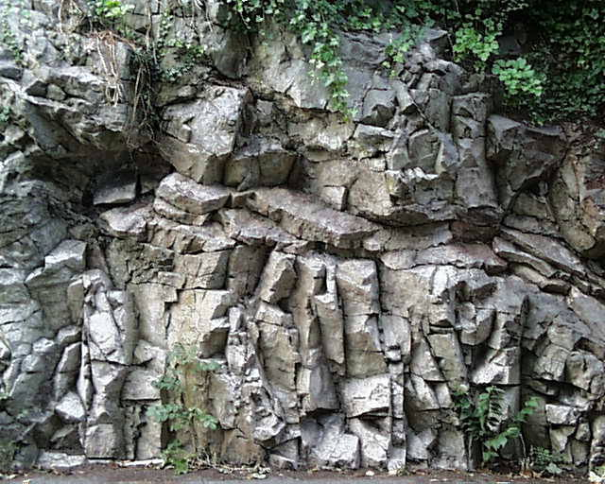

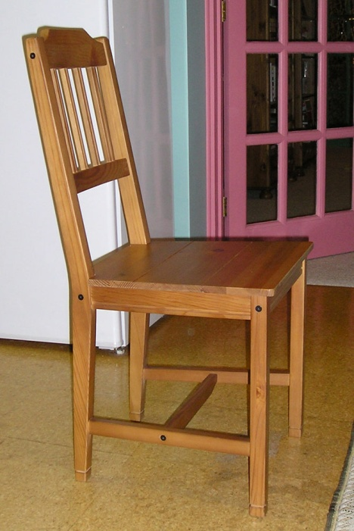


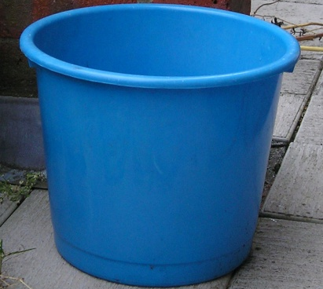
How many different substances are there?
How many
different substances
can you think of?
There are millions of different substances!
What are they all made of?

Slide 4

All substances are made of atoms
All substances are made of very tiny particles called atoms.
Many substances are made up of different types of atoms.
hydrogen and oxygen atoms
carbon and hydrogen atoms
iron, aluminium, silicon, oxygen and boron atoms
carbon, nitrogen, hydrogen, oxygen and sulphur atoms

Slide 5
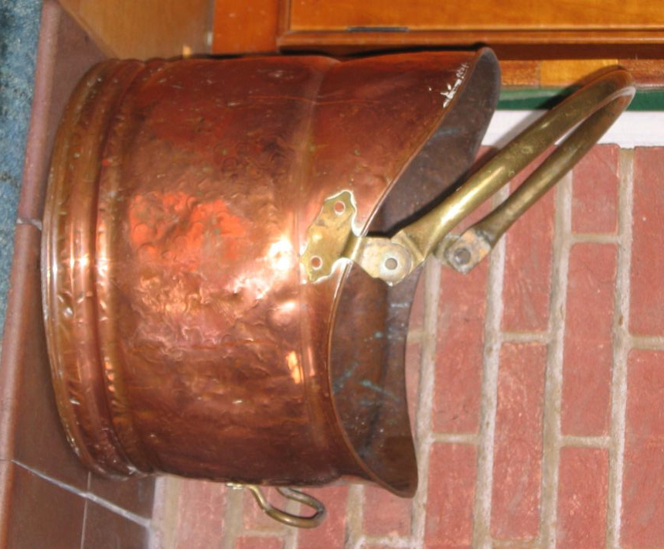
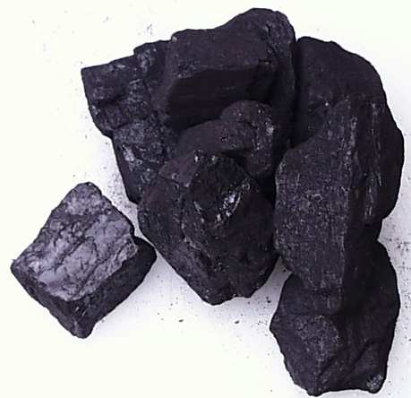

What is an element?
All substances are made of very tiny particles called atoms.
There are about one hundred substances that are made up of just one type of atom. These are the elements.
carbon
helium
copper
The elements are the simplest substances in the universe.
The elements are the building blocks of all other substances.

Slide 6
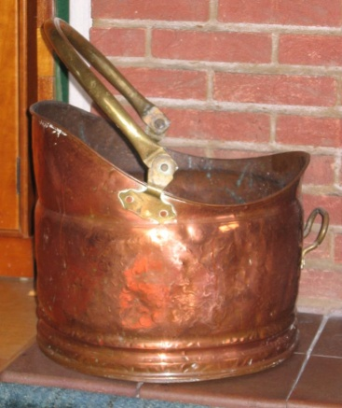
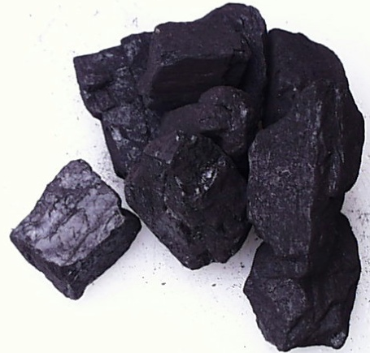

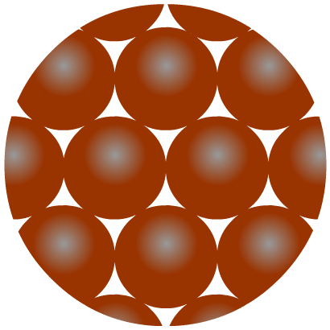
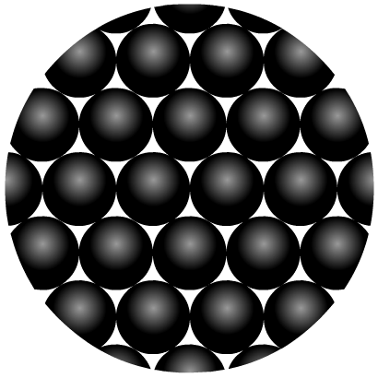
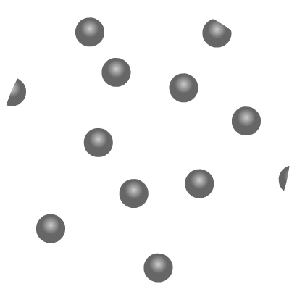
Atoms in elements
An element is a substance made up of only one type of atom.
Copper is an
element made up of
copper atoms only.
Carbon is an
element made up of
carbon atoms only.
Helium is an
element made up of
helium atoms only.

Slide 7

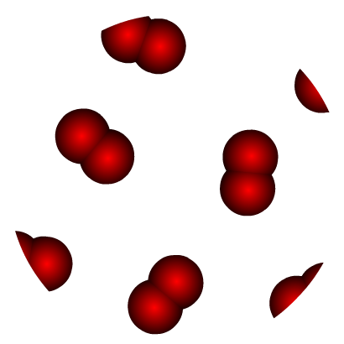
Atoms and molecules of elements
An element is a substance made up of only one type of atom.
In some elements, the atoms are joined in groups of two or more. A particle containing atoms grouped in this way is called a molecule.
Oxygen is an
element made up of
oxygen atoms only.
How many atoms
are there in an oxygen molecule?
Other elements, that contain atoms joined in molecules are hydrogen, nitrogen, chlorine and bromine.

Slide 8
Remember: An element is a substance that is made from one kind of atom only. It cannot be broken down into simpler substances.
atom
atom
An element
An element

Slide 9

Elements
Elements cannot be separated into simpler substance by physical or chemical means. All elements are found on the periodic table.

Slide 10
Introducing chemical symbols
A standard set of symbols is used to represent elements:
The symbol for many of the more common elements uses just the first letter of the name.
H =
hydrogen
O =
oxygen
C =
carbon
N =
nitrogen
F =
fluorine
I =
iodine
Others elements have the first two letters.
Some of the symbols are not always as you might expect.
Li =
lithium
Pb =
lead
Al =
aluminium
Au =
gold
He =
helium
Ag =
silver

Slide 11
How to write symbols for elements
Two important rules should be followed when writing the symbols of elements so that there is no confusion.
1. The first letter of an element’s symbol is always a capital letter.
e.g. N (not n) for nitrogen
2. If there are two letters in the element’s symbol, the second letter is always a small letter.
e.g. Co (not CO) for cobalt
No, Watson! It was
carbon monoxide
poisoning – not cobalt.

Slide 12
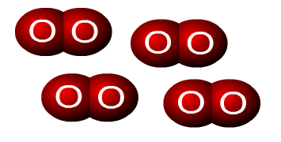
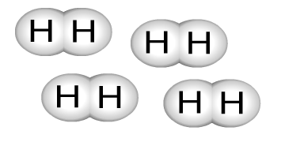
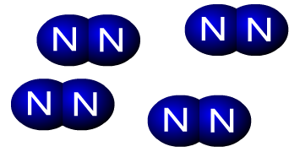
Symbols for molecules of elements
In some elements, the atoms are joined together and
form molecules. Combining the symbols of the atoms
in a molecule gives you the formula of the molecule.
What is the formula for the molecules in each element?
O₂
oxygen
There are groups of two atoms in each molecule.
H
hydrogen
2
N₂
nitrogen

Slide 13
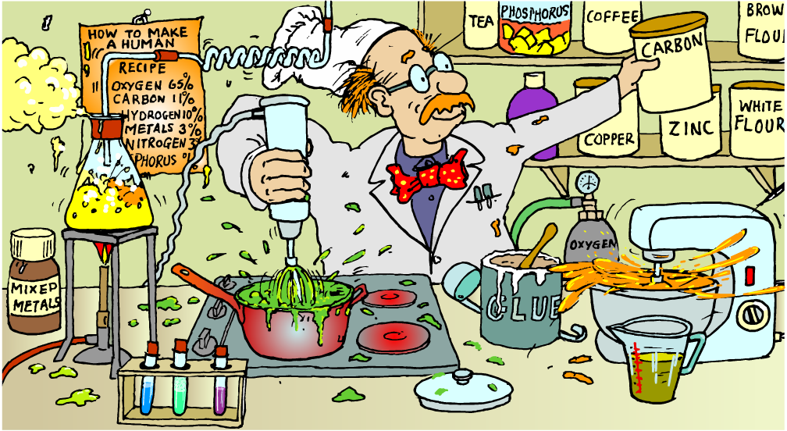
Combining elements
How is possible to have so many different materials from
a limited number of elements?

Slide 14
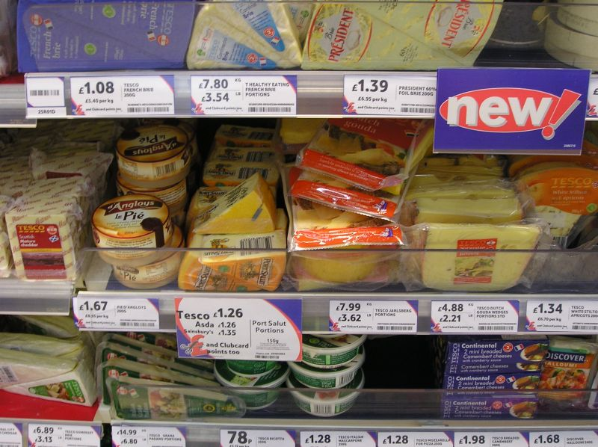
Combining elements
How do you get so many different cheeses?
What is the key ingredient in all cheeses?
Milk is combined with a small number of ingredients under different conditions to make a huge number of different cheeses.
In a similar way, a small number of elements can be combined in many different ways to make a huge number of different compounds.

Slide 15
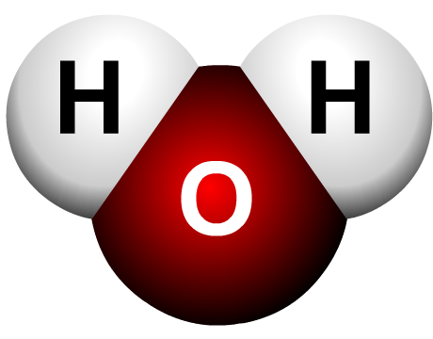
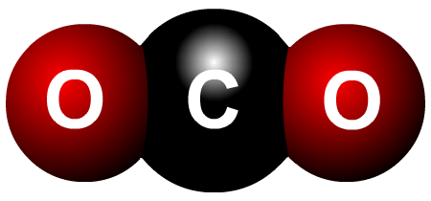
What is a compound?
A compound is the substance produced when two or more elements combine in a chemical reaction.
Two elements, hydrogen (H) and oxygen (O), combine to make the compound, water.
Which two elements combine to make the compound carbon dioxide?
A compound is always made up of two or more
different types of atom.

Slide 16
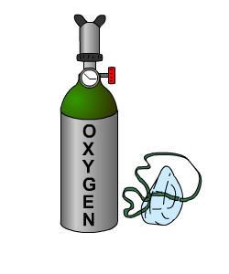


Making a compound – carbon dioxide
A compound has very different properties to the elements from which it is made.
elements
compound
carbon
oxygen
carbon dioxide
combines with
to make
A black solid which can be used as a fuel.
A colourless gas
which is essential
for life.
A colourless gas which is used
to put out fires.

Slide 17

Making a compound – water
What are the elements which make up water?
In what ways are the elements different to their compound?
elements
compound
hydrogen
oxygen
water
combines with
to make
A liquid which is essential to our lives and has many different uses.
A colourless gas which is used in hot air balloons.
A colourless gas which is essential
for life.

Slide 18
Remember: A compound is a substance that is made from more than one element.
atom
atom
A compound made up of 2 different elements
A compound made up of 7 different elements

Slide 19
A compound can be broken down into elements
An element
A compound made up of 3 different elements
An element
An element

Slide 20
In Summary:
Compounds are composed of two or more different elements joined by chemical bonds.
  Made of elements in a specific ratio
  that is always the same
  Has a chemical formula
  Can only be separated by
  chemical means, not physically
  -- Can be very different from the elements in them
H₂O
NaCl
CO₂

Slide 21

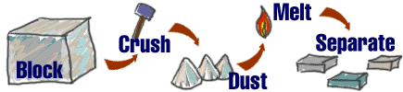
Mixtures
A combination of two or more pure substances that are not chemically combined.
substances held together by physical forces, not chemical
No chemical change takes place
Each item retains its properties
in the mixture
They can be separated physically
Chem4kids.com

Slide 22
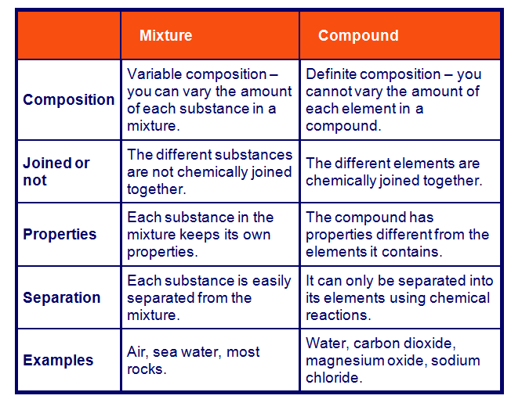
Mixtures vs. Compounds
http://www.bbc.co.uk/schools/ks3bitesize/science/chemistry/elements_com_mix_6.shtml

Slide 23
Can you identify the following?
You will be shown a series of photos. Tell if each photo represents an item composed of an element, compound, or mixture.
Review:
An element contains just one type of atom.
A compound contains two or more different atoms joined together.
A mixture contains two or more different substances that are only physically joined together, not chemically.
  A mixture can contain both elements and compounds.

Slide 24

Element, Compound, or Mixture?
Rocks

Slide 25
Element, Compound, or Mixture?
Rocks

Slide 26
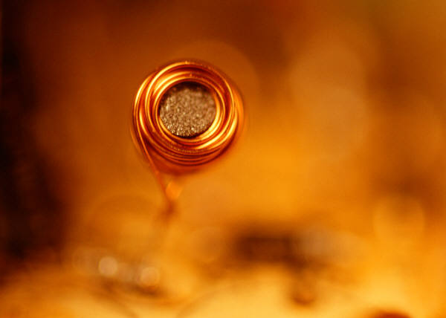
Element, Compound, or Mixture?
Copper

Slide 27
Element, Compound, or Mixture?
Copper
Cu

Slide 28
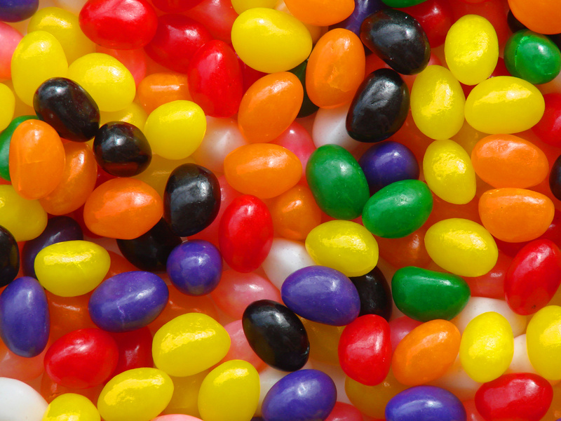
Element, Compound, or Mixture?
Jelly Beans

Slide 29
Element, Compound, or Mixture?
Jelly Beans

Slide 30
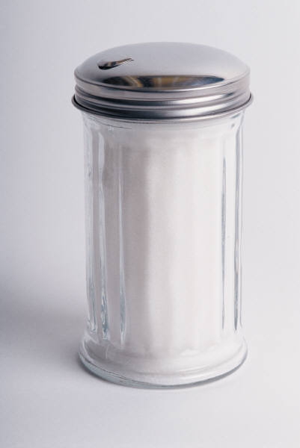
Element, Compound, or Mixture?
Table Sugar

Slide 31
Element, Compound, or Mixture?
Table Sugar
C₁₂H₂₂O₁₁

Slide 32
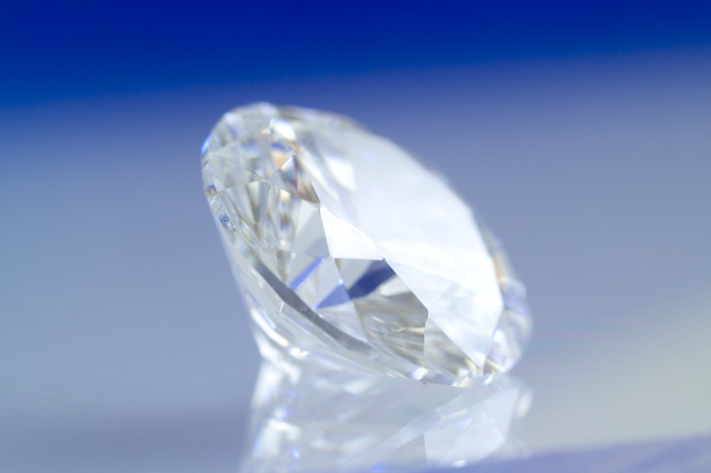
Element, Compound, or Mixture?
Diamond

Slide 33
Element, Compound, or Mixture?
Diamond
C

Slide 34

Element, Compound, or Mixture?
Tea

Slide 35
Element, Compound, or Mixture?
Tea

Slide 36
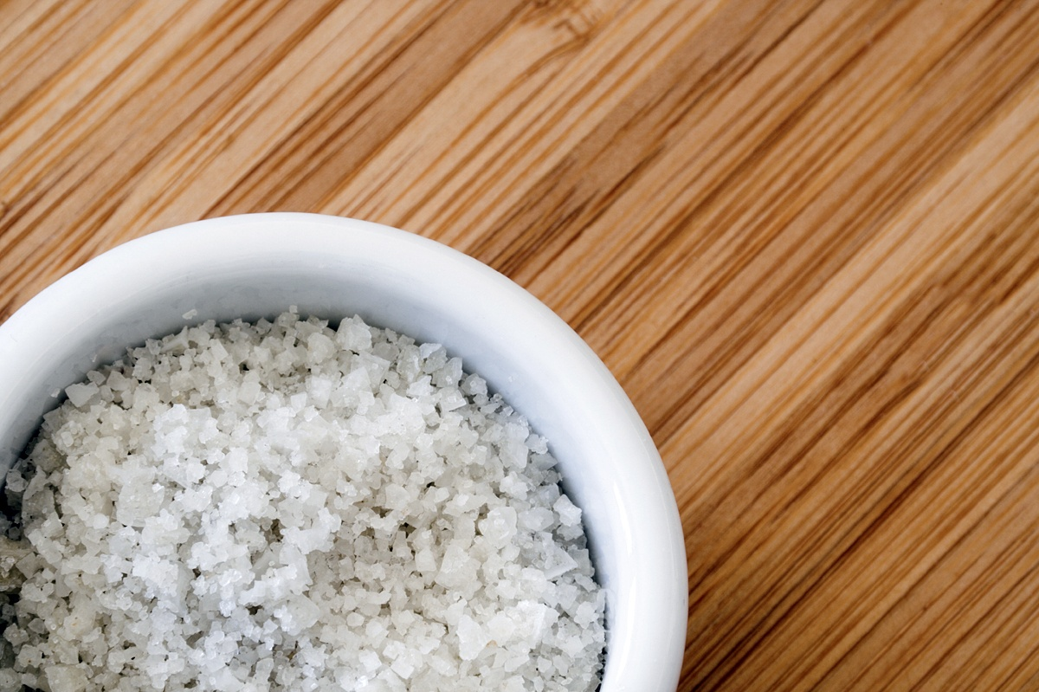
Element, Compound, or Mixture?
Salt

Slide 37
Element, Compound, or Mixture?
NaCl
Salt

Slide 38

Element, Compound, or Mixture?
Neon Gas

Slide 39
Element, Compound, or Mixture?
Ne
Neon Gas

Slide 40
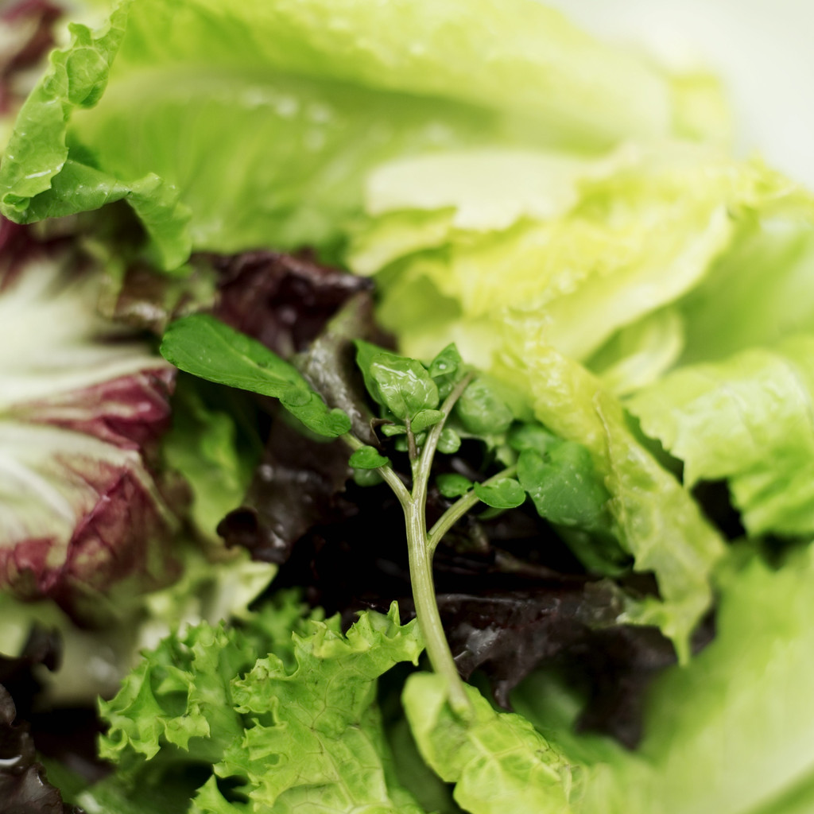
Element, Compound, or Mixture?
Salad

Slide 41
Element, Compound, or Mixture?
Salad

Slide 42

Element, Compound, or Mixture?
Pure Water

Slide 43
Element, Compound, or Mixture?
Pure Water
H₂O

Slide 44
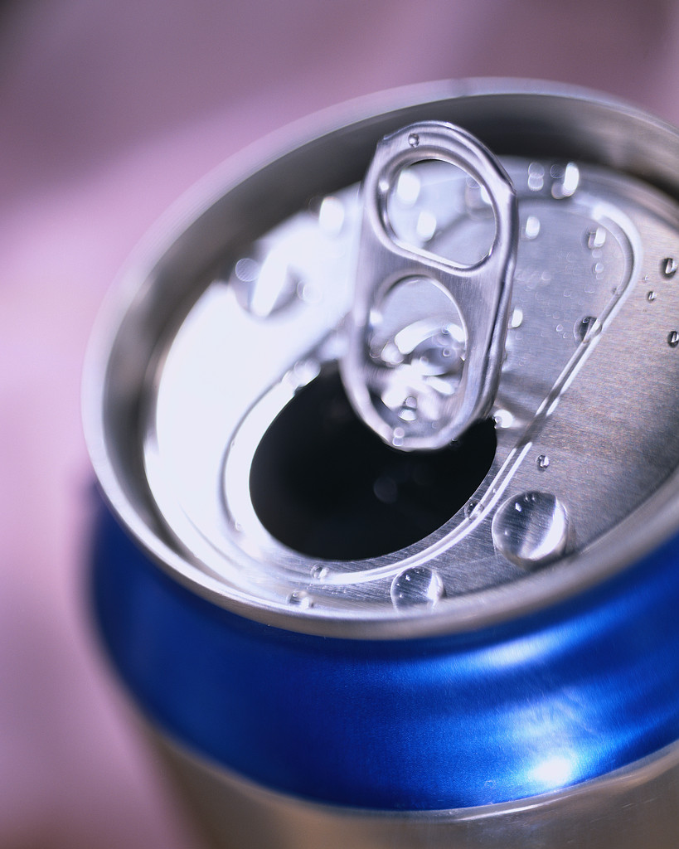
Element, Compound, or Mixture?
Aluminum

Slide 45
Element, Compound, or Mixture?
Aluminum
Al

Slide 46
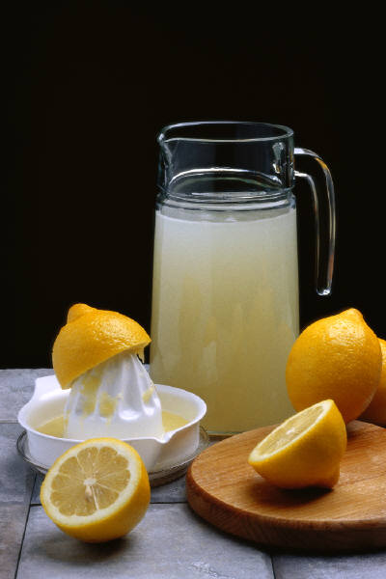
Element, Compound, or Mixture?
Lemonade

Slide 47
Element, Compound, or Mixture?
Lemonade

Slide 48
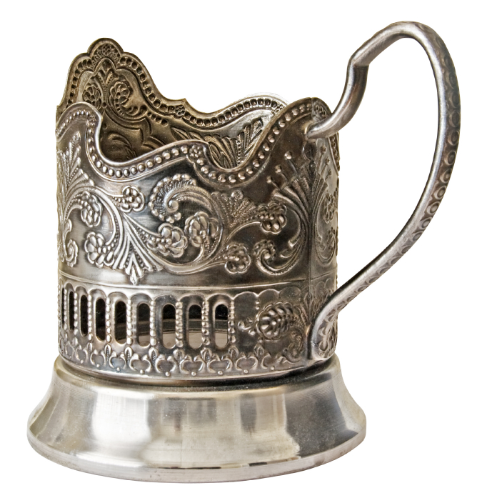
Element, Compound, or Mixture?
Silver

Slide 49
Element, Compound, or Mixture?
Silver
Ag

Slide 50

Element, Compound, or Mixture?
Sand

Slide 51
Element, Compound, or Mixture?
Sand

Slide 52
Chemical Formulas
Learning Goals:

Slide 53
Chemical Formulas
are combinations of chemical symbols
are a short way of representing a compound
tell how many atoms of each element are in each molecule of a compound
Notes:
14
13
13
13
13

Slide 54
Examples of chemical formulas
Ammonia is made of nitrogen (N) and hydrogen (H). A molecule of ammonia contains 1 atom of nitrogen and 3 atoms of hydrogen.
H
H
The chemical formula for ammonia is NH
N
H
3
Notes:
15
14
14
14
14

Slide 55
NH
3
Subscript-placed on lower right of symbol; tells how many atoms of the element are in the compound
Notes:
16
15
15
15
15

Slide 56
NH
3
No subscript means there is only one atom of that element
Notes:
17
16
16
16
16

Slide 57
Carbon dioxide is a compound made of carbon (C) and oxygen (O). A molecule of carbon dioxide has 1 carbon atom and 2 oxygen atoms.
What’s the chemical
formula for carbon
dioxide?
C
O
O
Notes:
18
17
17
17
17

Slide 58
Carbon Dioxide =
CO₂
C
O
O
Notes:
19
18
18
18
18

Slide 59
Sulfuric acid has the formula H₂SO₄.
How many atoms of each element are present in this compound?
        The correct answer is 2 hydrogen
        1 sulfur
        4 oxygen
Notes:
20
19
19
19
19

Slide 60
A BIG number out in front of the formula means you have more than one molecule. This number is called a coefficient.
2H₂O = 3H₂O=
O
H
O
H
H
H
H
H
O
H
O
O
H
H
H
Notes:
24

