Slide 1
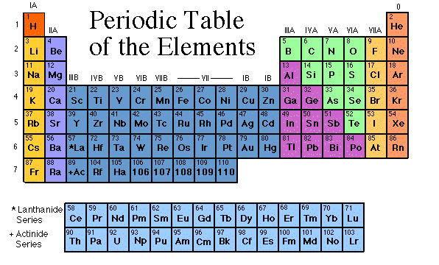
Coloring the Periodic Table Families
Some images are from www.chem4kids.com
www.middleschoolscience.com 2008

Slide 2
Coloring the Periodic Table Families
The Element Song
Some images are from www.chem4kids.com
www.middleschoolscience.com 2008

Slide 3
Families on the Periodic Table
Elements on the periodic table can be grouped into families bases on their chemical properties.
Each family has a specific name to differentiate it from the other families in the periodic table.
Elements in each family
react differently with
other elements.

Slide 4
Valence Electrons
The number of valence electrons an atom has may also appear in a square.
Valence electrons are the electrons in the outer energy level of an atom.
These are the electrons that are transferred or shared when atoms bond together.

Slide 5
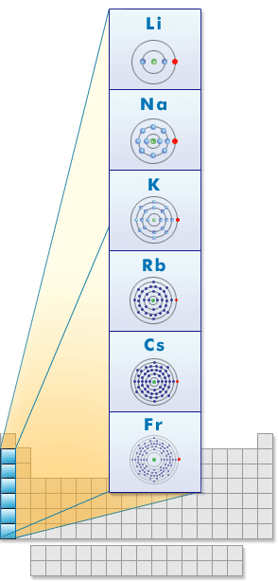
ALKALI METALS
Group 1
Hydrogen is not a member, it is a non-metal
1 electron in the outer shell
Soft and silvery metals
Very reactive, esp. with water
Conduct electricity
http://Alkali Metals Movie Clip
Image: http://www.learner.org/interactives/periodic/groups2.html

Slide 6
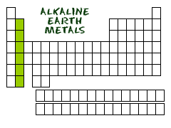
ALKALINE EARTH METALS
Group 2
2 electrons in the outer shell
White and malleable
Reactive, but less than Alkali metals
Conduct electricity
Alkali and Alkaline Metals Clip

Slide 7
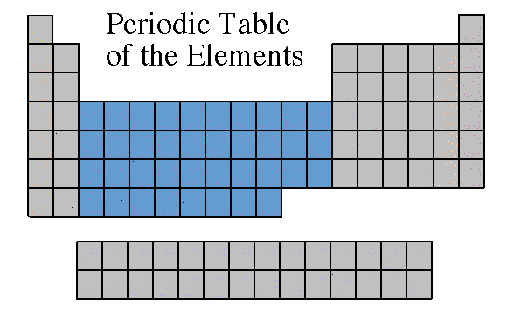
TRANSITION METALS
Groups in the middle
Good conductors of heat and electricity.
Some are used for jewelry.
The transition metals are able to put up to 32 electrons in their second to last shell.
Can bond with many elements in a variety of shapes.
Transition Metals

Slide 8
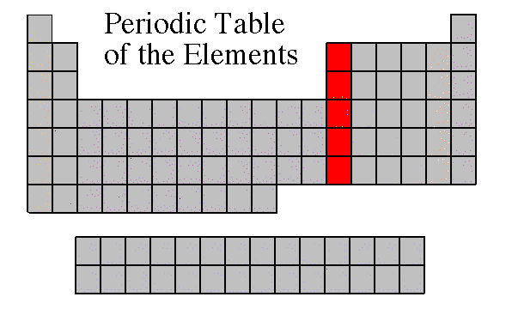
BORON FAMILY
Group 3
3 electrons in the outer shell
Most are metals
Boron is a metalloid
Boron Family Movie Clip

Slide 9
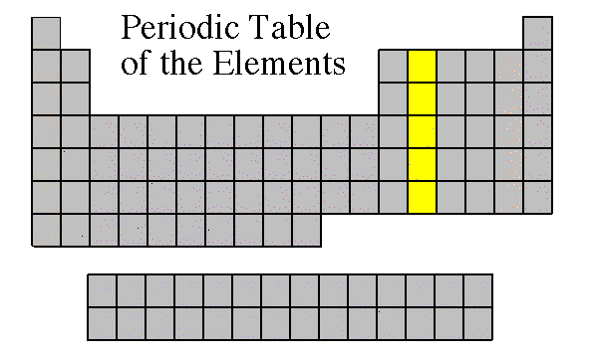
CARBON FAMILY
Group 4
4 electrons in the outer shell
Contains metals, metalloids, and a non-metal Carbon (C)
Carbon Family Movie Clip

Slide 10
Carbon Family
Atoms of this family have 4 valence electrons.
This family includes a non-metal (carbon), metalloids, and metals.
The element carbon is called the “basis of life.” There is an entire branch of chemistry devoted to carbon compounds called organic chemistry.

Slide 11
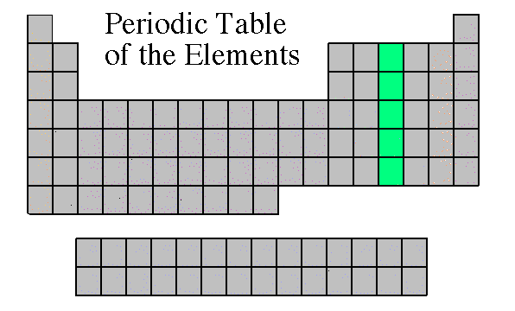
NITROGEN FAMILY
Group 5
5 electrons in the outer shell
Can share electrons to form compounds
Contains metals, metalloids, and non-metals
Nitrogen Family Movie Clip
Nitrogen Family Movie Clip - Best

Slide 12
Nitrogen Family
The nitrogen family is named after the element that makes up 78% of our atmosphere.
This family includes non-metals, metalloids, and metals.
Atoms in the nitrogen family have 5 valence electrons. They tend to share electrons when they bond.
Other elements in this family are phosphorus, arsenic, antimony, and bismuth.

Slide 13
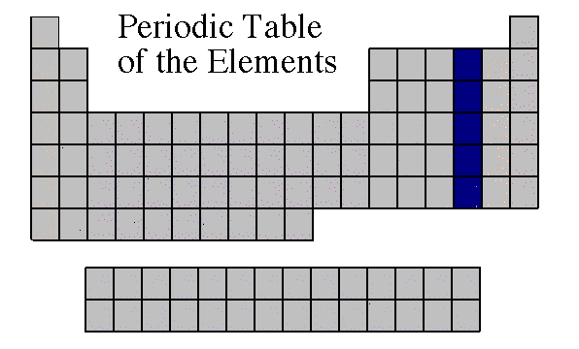
OXYGEN FAMILY
Group 6
6 electrons in the outer shell
Contains metalloids and non-metals
Reactive
Oxygen Family Clip

Slide 14
Oxygen Family
Atoms of this family have 6 valence electrons.
Most elements in this family share electrons when forming compounds.
Oxygen is the most abundant element in the earth’s crust. It is extremely active and combines with almost all elements.

Slide 15
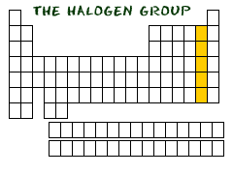
Halogens
Group 7
7 electrons in the outer shell
All are non-metals, except At
Very reactive are often bonded with elements from Group 1
Halogen Family Clip

Slide 16
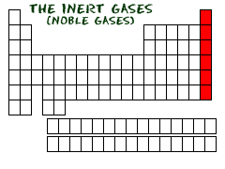
Noble Gases
Group 8
Exist as gases
Non-metals
8 electrons in the outer shell = Full
Helium (He) has only 2 electrons in the outer shell = Full
Not reactive with other elements
Noble Gas Clip
Noble gas clip

Slide 17
Noble Gases
Noble Gases are colorless gases that are extremely un-reactive.
One important property of the noble gases is their inactivity. They are inactive because their outermost energy level is full.
Because they do not readily combine with other elements to form compounds, the noble gases are called inert.
The family of noble gases includes helium, neon, argon, krypton, xenon, and radon.
All the noble gases are found in small amounts in the earth's atmosphere.

Slide 18
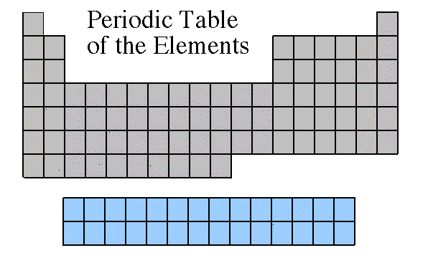
Rare Earth Metals
Some are Radioactive
The rare earths are silver, silvery-white, or gray metals.
Conduct electricity
Rare Earth Element Movie Clip

Slide 19
Using the next slide, OUTLINE the metals, nonmetals, and metalloids on your periodic table!

Slide 21
Properties of Metals
Metals are good conductors of heat and electricity.
Metals are shiny.
Metals are ductile (can be stretched into thin wires).
Metals are malleable (can be pounded into thin sheets).
A chemical property of metal is its reaction with water which results in corrosion.

Slide 22
Properties of Non-Metals
Non-metals are poor conductors of heat and electricity.
Non-metals are not ductile or malleable.
Solid non-metals are brittle and break easily.
They are dull.
Many non-metals are gases.
Sulfur

Slide 23
Properties of Metalloids
Metalloids (metal-like) have properties of both metals and non-metals.
They are solids that can be shiny or dull.
They conduct heat and electricity better than non-metals but not as well as metals.
They are ductile and malleable.
Silicon

Slide 26
Families Periods
Columns of elements are called groups or families.
Elements in each family have similar but not identical properties.
For example, lithium (Li), sodium (Na), potassium (K), and other members of family IA are all soft, white, shiny metals.
All elements in a family have the same number of valence electrons.
Each horizontal row of elements is called a period.
The elements in a period are not alike in properties.
In fact, the properties change greatly across even given row.
The first element in a period is always an extremely active solid. The last element in a period, is always an inactive gas.

Slide 27
Hydrogen
The hydrogen square sits atop Family AI, but it is not a member of that family. Hydrogen is in a class of its own.
It’s a gas at room temperature.
It has one proton and one electron in its one and only energy level.
Hydrogen only needs 2 electrons to fill up its valence shell.

Slide 28
What does it mean to be reactive?
We will be describing elements according to their reactivity.
Elements that are reactive bond easily with other elements to make compounds.
Some elements are only found in nature bonded with other elements.
What makes an element reactive?
An incomplete valence electron level.
All atoms (except hydrogen) want to have 8 electrons in their very outermost energy level (This is called the rule of octet.)
Atoms bond until this level is complete. Atoms with few valence electrons lose them during bonding. Atoms with 6, 7, or 8 valence electrons gain electrons during bonding.

Slide 29
5

Slide 32
The end of the study guide.
The Element Song!

