Slide 1
Chapter 4 Views of Earth’s Past
Pg 111-133

Slide 2
4.1 Earth’s past is revealed in rocks and fossils

Slide 3
Respond with Agree or Disagree to the following Statements.
Fossils only represent bones and shells of extinct animals. Soft tissue can never be fossilized.
Fossils can be found in polar areas.
Fossils are pieces of dead animals and plants.
Fossils are only found in sedimentary rock.
Fossils cannot tell us about the environment they lived in long ago.

Slide 4
Fossils
Fossils are preserved remains or traces of living things.
Most fossils form when living things die and are buried by sediments.
The sediments slowly harden into rock and preserve the shape of the organisms.
Found only in sedimentary rock.
Notes:
Watch US video Natural Phenomena: Rocks, Fossils, and Earth’s History, segment The Formation of Fossils (3 min)

Slide 5
Different Types of Fossils
Original Remains
Molds and casts
Petrified wood
Carbon films
Trace fossils

Slide 6
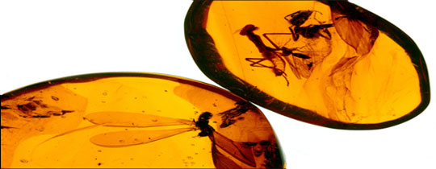
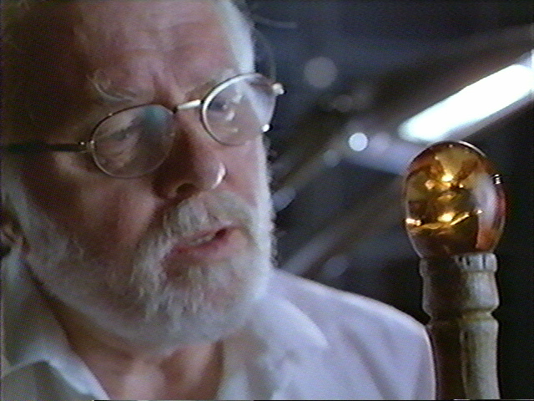
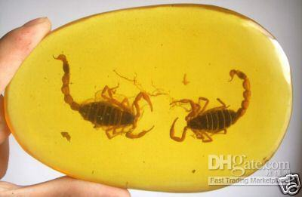
What are original remains?
Notes:
Based on these pictures, tell your shoulder partner what you think original remains are. Watch US video Earth Science: Fossils, Amber segment (4 min) link on top left picture.

Slide 7
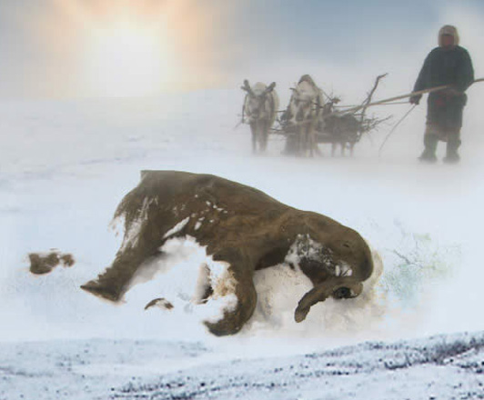
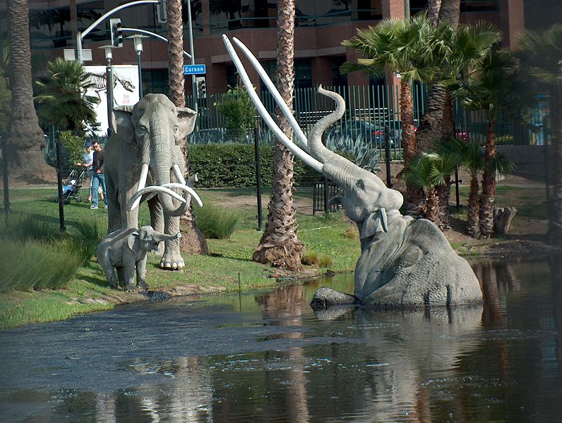
What are original remains?
Notes:
US video Earth Science: Fossils, Segment Wooly Mammoth
http://ngm.nationalgeographic.com/2009/05/mammoths/latreille-photography
Based on these pictures, tell your shoulder partner what you think original remains are.

Slide 8
Original remains
Are fossils that are the actual bodies or body parts of living things. They have changed very little, if at all, over time.
They are found in ice, amber, or tar.
They give scientists the most information about living things from the past, but they are very rare.
Notes:
Safari video: Bill Nye: Fossils, chapter 4

Slide 9
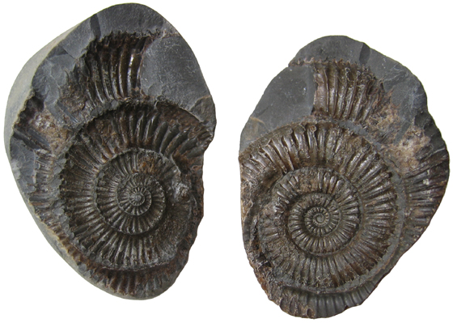
Molds and casts
a mold of a dead organism is made and it fills with sediment that hardens into stone (the cast)
Notes:
Bill Nye hyperlink on title

Slide 10
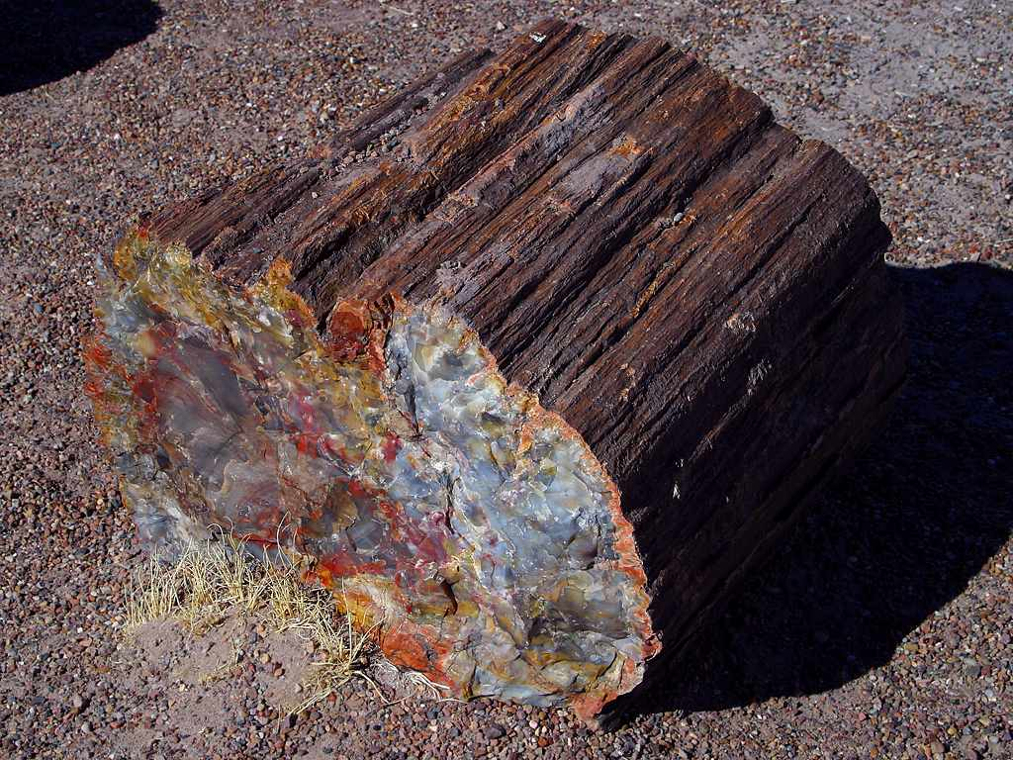
Petrified Remains
Are fossils in which minerals fill in the cells of an organism.
When the object is buried by sediment, water rich in minerals seeps into the cells. After the water evaporates, hardened minerals are left behind, turning the organism to rock.
Ex: petrified wood
Notes:
Safari video: Bill Nye: Fossils, chapter 4

Slide 11
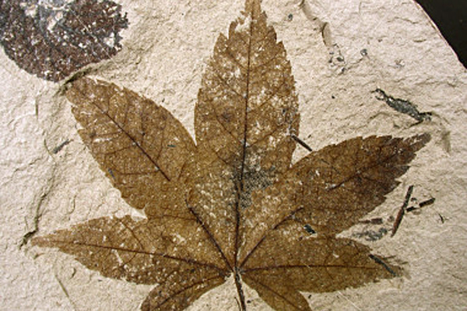
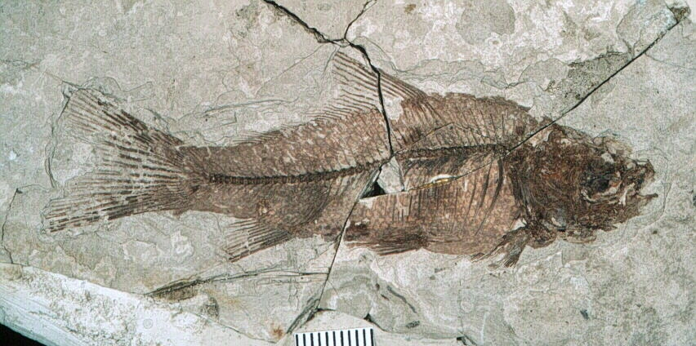
Carbon Films
An extremely thin coating of carbon on rock that forms when materials that make up an organism become gases and escape leaving only carbon behind.
These fossils show details of soft tissue.
Notes:
Safari video: Bill Nye: Fossils, chapter 4

Slide 12
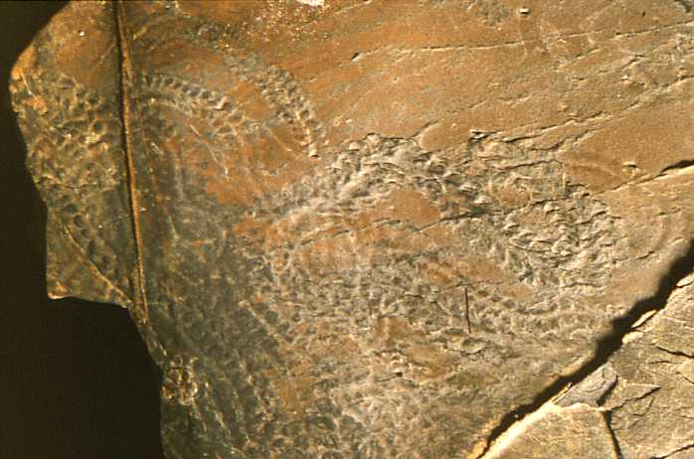
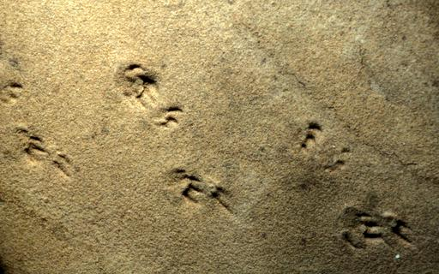
Trace fossils-
indirect evidence of an organism such as footprints, trails, animal holes, feces etc.
Notes:
Safari, Bill Nye: Fossils, chapter 7 (click on left picture)
Hyperlink on title

Slide 13
Fossils
Form in several ways:
Original Remains
Molds and casts
Petrified wood
Carbon films
Trace fossils
Unaltered remains
Altered remains
Indirect evidence

Slide 14
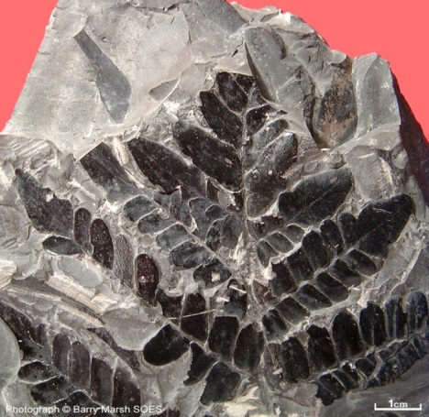
Conditions Favoring Preservation
Two conditions are important for preservation: rapid burial and the possession of hard parts.
Notes:
Safari video: Bill Nye: Fossils, chapter 4

Slide 15
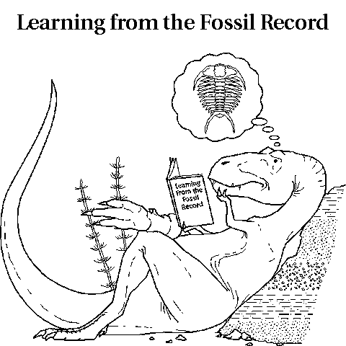
Why Study Fossils?
Scientists study fossils to learn what past life forms were like and how organisms have changed over time.
Fossils can give us an idea of what the environment was like.

Slide 16
Respond with Agree or Disagree to the following Statements.
Fossils only represent bones and shells of extinct animals. Soft tissue can never be fossilized.
Fossils can be found in polar areas.
Fossils are pieces of dead animals and plants.
Fossils are only found in sedimentary rock.
Fossils cannot tell us about the environment they lived in long ago.

Slide 17
Reflect
On your Reflection doc, put 3/5 for the date.
Then number 3,2,1 down the left side of the reflection box.
Next to the 3, explain three new things you learned about fossils.
Next to the 2, share two questions you still have.
Next to the 1, agree/disagree statement that you changed your mind about and why.

